Slide 1

Dawood University Of Engineering And Technology
Topic Lahore Resolution 1940
Department Of Cyber Security Section A2
Presented By :
Bisma (25F-CY-89 )
Bushra(25F-CY-79)
Muqaddas(25F-CY-78)
Course Instructor : Sir Faisal

Slide 2
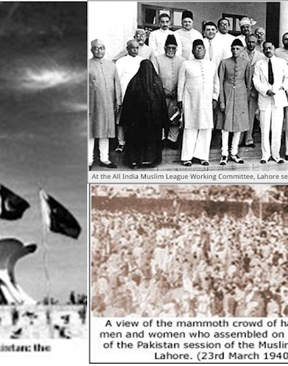
The Lahore Resolution:1940
The Lahore Resolution, passed on March 23, 1940, at Minto Park, Lahore, stands as the most critical turning point in the modern history of South Asia. Presented by A.K. Fazlul Huq during the annual session of the All-India Muslim League, it formally rejected the idea of a united India and called for the creation of independent states in the Muslim-majority regions of the North-West and East. This historic declaration was fueled by the Two-Nation Theory, which argued that Muslims and Hindus were distinct nations requiring separate political sovereignty to protect their religious, cultural, and economic rights.

Slide 3
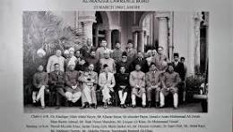
Historical Background: Muslim Identity in British India
Diverse Landscape
British India comprised a diverse religious landscape, with Muslims forming a significant, yet minority, population.
Fears of Marginalization
Muslims grew increasingly concerned about political marginalization under the Hindu-majority Congress rule (1937-1939).
Two-Nation Theory
The emerging Two-Nation Theory posited that Muslims and Hindus were distinct
nations, each deserving separate political rights.
Early Safeguards
The Muslim League actively pursued political safeguards and separate electorates to protect Muslim interests.

Slide 4
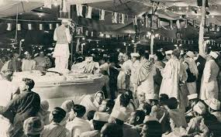
The Lahore Session, March 1940: Setting the Stage
The Historic Venue: Minto Park, Lahore In March 1940, Minto Park (now Greater Iqbal Park) became the center of the political world. Choosing Lahore—the heart of the Muslim-majority Punjab—was a strategic move. The venue hosted a massive gathering of thousands from across the subcontinent, turning a political meeting into a powerful national movement
Jinnah’s Leadership: The Visionary Architect Muhammad Ali Jinnah presided over the session with a clear and firm vision. In his historic presidential address, he gave a logical foundation to the Two-Nation Theory, arguing that Muslims were a distinct nation entitled to their own homeland. His leadership provided the unity and direction the Muslim League needed to demand sovereignty.
The Resolution Mover :AK. Fazlul Huq The resolution was formally moved by A.K. Fazlul Huq, the Chief Minister of Bengal, famously known as "Sher-e-Bengal" (The Lion of Bengal). His participation was crucial as it proved that Muslims from both the East (Bengal) and the West of India were united in the demand for a separate state.
.

Slide 5
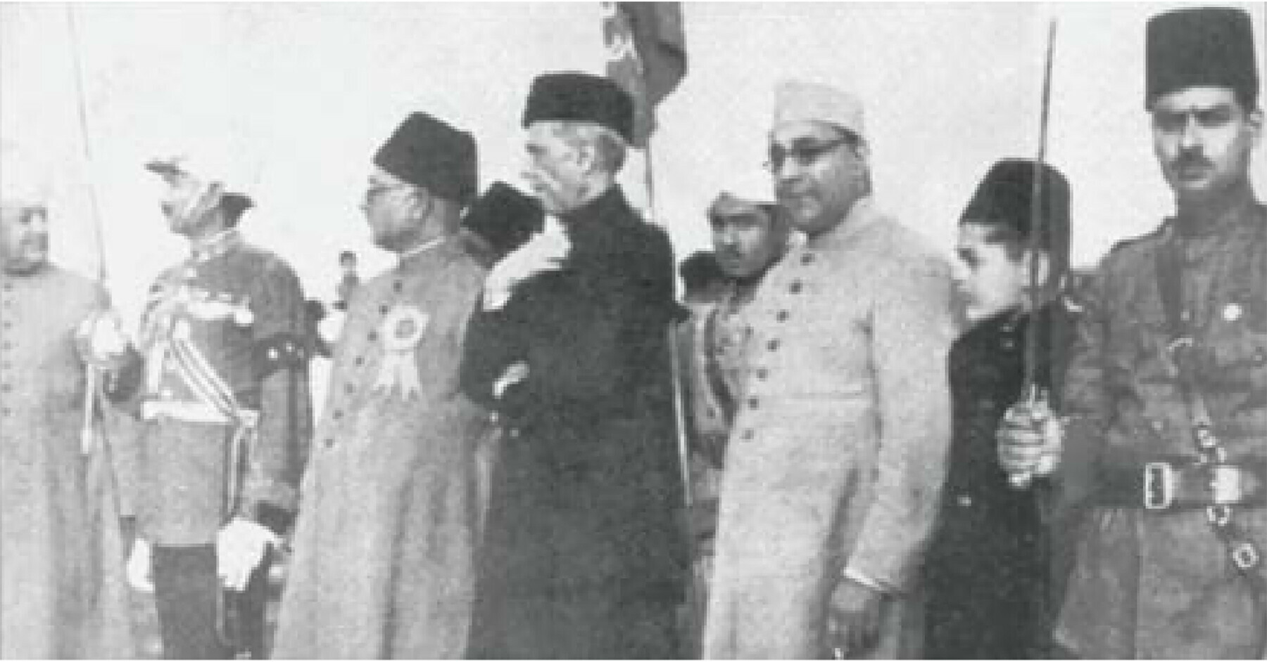
The Pakistan Resolution: Key Demands and Provisions
Separate Homeland/States: The primary demand was that Muslim-majority regions in the Northwest (Punjab, NWFP, Sindh, Baluchistan) and the Northeast (Bengal, Assam) of India be grouped together to form independent, sovereign, and autonomous states.
Two-Nation Theory: The resolution formally solidified the stance that Hindus and Muslims were two separate nations, not just two religious communities, and that their coexistence in a single Indian state was untenable.
Rejection of United India: The resolution strongly rejected the federal system outlined in the Government of India Act 1935, opposing the idea of a single united government for the entire subcontinent.
Protection for Minorities: The resolution required that in the new states, constitutionally binding provisions be made for the protection of religious, cultural, and political rights of minorities, and reciprocal arrangements for Muslims in minority areas of India.
Constitutional Approval: The Muslim League stated that no constitutional plan would be accepted by the Muslims unless it was based on these principles of geographic separation and autonomy.

Slide 6
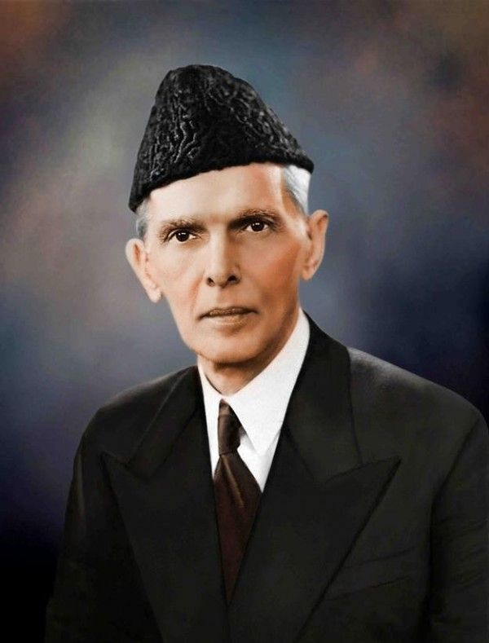
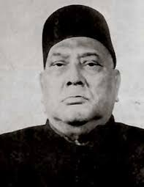

Principal Leaders Behind the Resolution
As the Chief Minister of undivided Bengal, he officially presented the historical Lahore Resolution on March 23, 1940, bringing crucial support from the eastern province
Architect of Muslim political unity and the revered leader of the Pakistan Movement.
Muhammad Ali Jinnah
AK Fazlul Haq
the ideological, intellectual, and spiritual architect of the 1940 Pakistan Resolution. Through his 1930 Allahabad Address, he provided the foundational vision of a separate, sovereign Muslim state in India, transforming Muslim identity from a minority to a distinct nationhood that motivated the demand for Pakistan.
Allama Iqbal

Slide 7
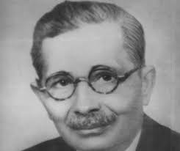
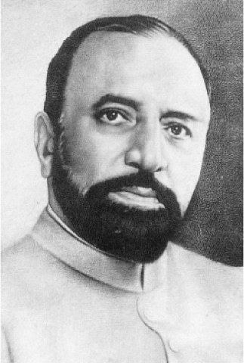

Chaudhry Khaliquzzaman (The Seconder)
A prominent leader from the United Provinces (UP), he seconded the resolution. Since he represented a Muslim-minority province, his support was a powerful statement; it showed that even Muslims living in areas that would not become part of Pakistan were willing to sacrifice for the creation of a sovereign Muslim state.
Sir Abdulllah Haroon:
Represented Sindh, providing the essential backing of the southern coastal region.
Sardar Aurangzeb
Khan was a key participant who represented the North-West Frontier Province (NWFP). His presence was a powerful statement that the people of the Frontier stood firmly with the Muslim League, countering the influence of the Congress in that region.

Slide 8
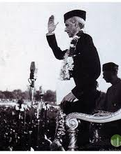
Quaide Azam’s Speech
In his historic 1940 Presidential Address, Muhammad Ali Jinnah delivered a powerful and logical argument that redefined the political future of the subcontinent. He categorically rejected the idea that Muslims were merely a religious minority, asserting instead that they were a complete nation by any definition.
Jinnah articulated the Two-Nation Theory, explaining that Islam and Hinduism were not just religions, but two distinct and conflicting social orders. He argued that since the two communities belonged to different civilizations—with different heroes, histories, and social codes—they could never be forced into a single state without creating disaster. He warned that a British-style democratic system in a united India would inevitably lead to a "Hindu Raj," where Muslims would be permanently suppressed by a numerical majority. Therefore, he concluded that the only path to peace and stability was the partition of India into autonomous national states, allowing Muslims to govern themselves in their majority regions according to their own cultural and spiritual values.

Slide 9
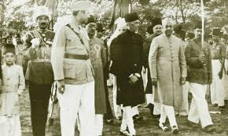
Political Context and Opposition
Disappointment with Congress Rule (1937–1939
After the 1937 elections, the Congress formed governments in several provinces, which the Muslim League perceived as biased and discriminatory, leading to fears of a "Hindu Raj".
Failure of Constitutional Safeguards:
The Muslim League believed the 1935 Act would not protect Muslim minority rights and that a strong central government would threaten their religious, cultural, and political identity.
The Two-Nation Theory: The League, led by Muhammad Ali Jinnah, officially adopted the stance that Muslims and Hindus were distinct nations with different cultures, traditions, and civilizations.
The British Strategy:
The British were desperate for Indian support in the war. Jinnah used this leverage to insist that no constitutional change be made without the consent of the Muslim League.

Slide 10
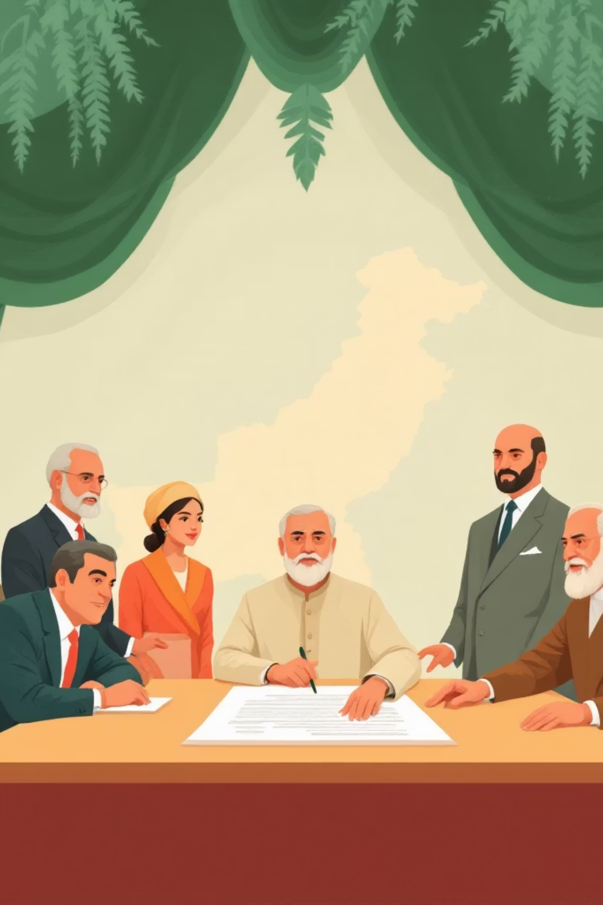
Impact and Significance of the Resolution
The Lahore Resolution of 1940 had a profound and irreversible impact on the history of the Indian subcontinent, serving as the definitive catalyst for the creation of Pakistan. Its primary significance lay in providing the Muslim community with a clear, tangible goal—sovereignty—which replaced the previous vague demands for minority safeguards and constitutional weightage. By formalizing the Two-Nation Theory, the resolution fundamentally altered the political discourse of the era; it forced both the British and the Indian National Congress to acknowledge that the Muslims were not merely a minority group, but a distinct nation entitled to its own territory. Furthermore, the resolution’s impact was instrumental in unifying the Muslim masses. It bridged regional divides, bringing together Muslims from the North-West and the East (Bengal) under a single political banner. This newfound unity transformed the All-India Muslim League into a formidable national power, making partition the central theme of all future constitutional negotiations. Ultimately, the Lahore Resolution acted as the foundational blueprint for the 1947 partition, successfully shifting the trajectory of the freedom struggle toward the birth of a new, independent Islamic state.

Slide 11
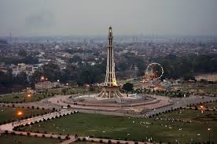
Legacy and Commemoration
Pakistan Day
National Narrative
March 23 is annually celebrated as Pakistan Day, a national holiday commemorating the resolution.
It continues to shape Pakistan's political discourse and national narrative, reinforcing its foundational principles.
Symbol of Self-Determination
Historic Landmarkz
Minar-e-Pakistan stands as a revered historic monument and a popular tourist landmark, drawing visitors from all over.
The Lahore Resolution remains a powerful symbol of Muslim political identity and their right to self-determination.

Slide 12
Conclusion
the Lahore Resolution was the decisive turning point that made the creation of Pakistan inevitable. By formalizing the Two-Nation Theory, it moved the Muslim struggle beyond the quest for minority rights and toward the attainment of national sovereignty. It remains the most significant document in the history of the movement, serving as a testament to the visionary leadership of Quaid-e-Azam and the collective will of a people determined to shape their own destiny. Today, it stands as the ideological cornerstone upon which the Islamic Republic of Pakistan was built."

Slide 13
Thank You

